Slide 1
Sum of Revenue by Card_Category
Power BI Desktop
40M
Sum of Revenue
Activation_30_Days Blue-collar Businessman Govt
Retirees
Selfemployeed
White-collar Total

20M
1 | 8.57% | 12.00% | 8.00% | 5.14% | 16.57% | 6.29% | 56.57%
0 | 6.29% | 6.86% | 8.57% | 5.14% | 11.43% | 5.14% | 43.43%
Total | 14.86% | 18.86% | 16.57% | 10.29% | 28.00% | 11.43% | 100.00%
0M
Blue
Silver
Gold
Platinum
Card_Category
Sum of Total_Trans_Amt by week_num2 and Month
1.0M
week_num2
Previous_Week_Revenue Current_week_Reveneue Wow_revenue
Sum of Total_Tra…
1 1035629
2 1035629 1053089 1.7% 3 1053089 1148250 9.0%
4 1148250 1071919 -6.6%
5 1071919 1064578 -0.7%
0.8M
January
January January January January February February February February March March March March
April April April April April May May May May June
1 2 3 4 5 6 7 8 9 10 11 12 13 14 15 16 17 18 19 20 21 22 23
Month
6 1064578 1121745 5.4% 7 1121745 1099909 -1.9%
Total 1070439 933134 -12.8%
Delinquent_Acc
%GT Count of Delinquent_Acc

0
94.59%
1
5.41%
Total
100.00%

Slide 2
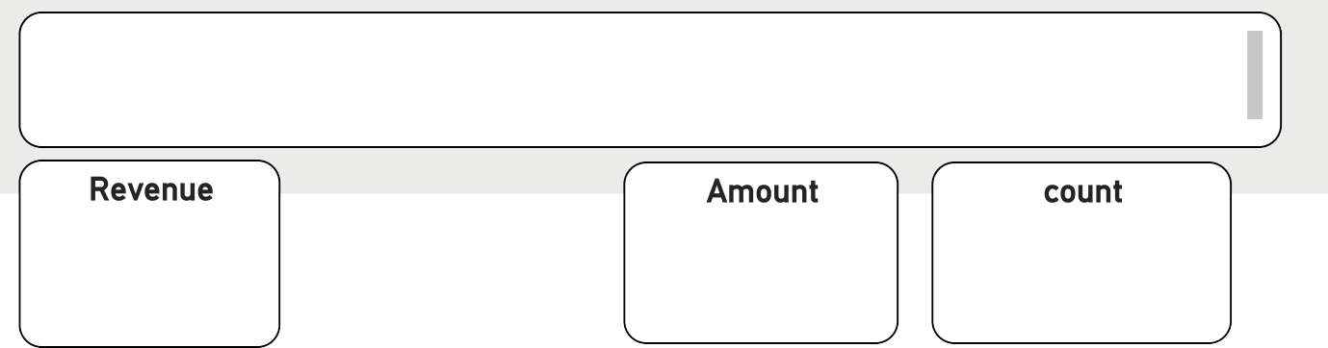
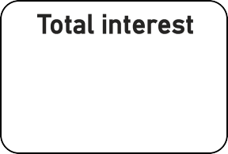
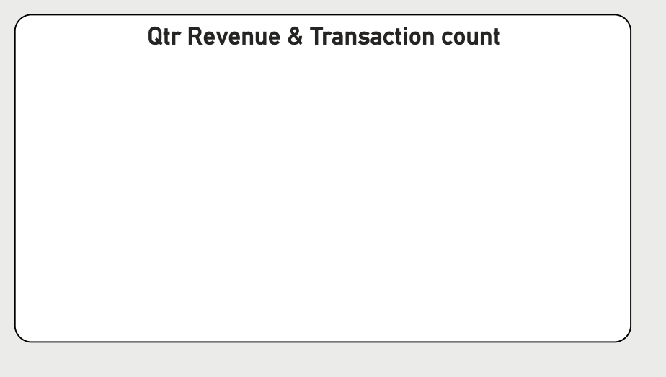
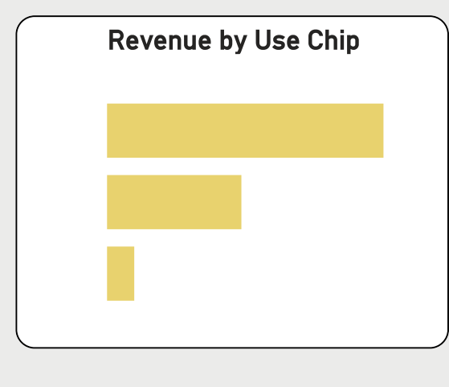
Credit card Transaction Report
Power BI Desktop
Q4 | Q3 | Q2 | Q1
Week_Start_Date

All 
Revenue
55M
Total interest
8M
Amount
45M
count
656K
Silver | Blue | Gold | Platinum
F
M
High
LOW
Med
Card_Category | Sum of Revenue | Sum of Total_Trans_Amt  | Sum of Interest_Earne
Blue | 46139398 | 36957875 | 64,95,887.7
Silver | 5586332 | 4586746 | 8,12,081.2
Gold | 2454072 | 2024078 | 3,73,784.1
Total | 55315410 | 44522013 | 78,43,382.2
Qtr Revenue & Transaction count
Revenue by Use Chip
14M 14M 166.6K
13M
Sum of Total_Trans_Vol
Sum of Revenue
14M
10M
164.2K
165K
Swipe
35M
163.3K
Chip
17M
0M
161.6K
160K
Online
3M
Q1
Q2
Q3
Q4
Qtr
Revenue by Expenditure type
Revenue by Education
Revenue by Customer job
CustomerAcq cost
Bills
14M
Graduate
22M
Busines…
17M
Blue
46M
Entertai…
10M
High Sc…
11M
White-c…
10M
Silver
6M
Fuel
9M
Unknown
8M
Selfem…
8M
Grocery
9M
Uneduc…
8M
Govt
8M
Gold
2M
Food
8M
Post-Gr…
3M
Blue-co…
7M
Platinum 1M
Travel
6M
Doctorate
2M
Retirees
5M
0M
20M
40M

Slide 3
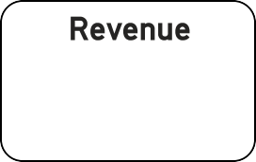
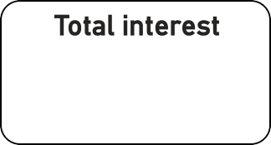
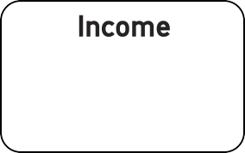

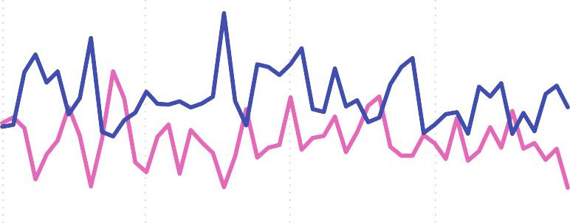
Credit Card Customer Report
Power BI Desktop
Week_Start_Date 
Q4
Q3
Q2
Q1
All 
Revenue
Total interest
7.84M
Income
CCS
55M
12M
3.5
Silver | Blue | Gold | Platinum
M
30M
F
25M
Revenue vs Gender
Revenue by AgeGroup
Ge… F M
Gender F M
0.8M
Customer_Job
Sum of Revenue
Sum of Interest_Earned

Sum of Income
0.72M
0.64M
0.56M
Blue-collar
55315410
78,43,382.23
1254753
0.77M
0.69M
0.67M
40-50
50-60
30-40
60 a…
20-30
0.27M
Businessman
55315410
78,43,382.23
3390512
Sum of Revenue
0.32M
Govt
55315410
78,43,382.23
2060738
0.6M
0.55M
0.56M
_{0.52M} 0.54M
Retirees
55315410
78,43,382.23
944278
0.49M
0.52M
Selfemployeed
55315410
78,43,382.23
2346643
0.4M
0.41M
White-collar
55315410
78,43,382.23
1688420
0.38M
0.38M
0.38M
Jan 2023
Apr 2023
Jul 2023
Year
Oct 2023
0.0M
0.5M
Total
55315410
78,43,382.23
11685344
Revenue
Tos 5 states
Gender F M
Revenue by Marital
Gender F M
Revenue by Income Group
Gender F M
Revenue by Dependent
Gender F M
Revenue by Education
Gender F M
CA
0.20M
0.09M
Gradu… 0.23M
High S… 0.24M
Unkno… Unedu… Doctor… Post-G…
0.26M
Married 0.25M
0.40M
High
0.56M
4
0.13M
0.16M 0.18M
FL
0.23M
NY 0.07M
0.17M
LOW
0.31M
Single 0.18M 0.26M
2 0.10M 0.15M
0.12M 0.16M
TX 0.08M
0.13M
NJ 0.08M
Unknown
Med
0

